Slide 1
Time Series Analysis
Md. Ismail Hossain Riday

Slide 2

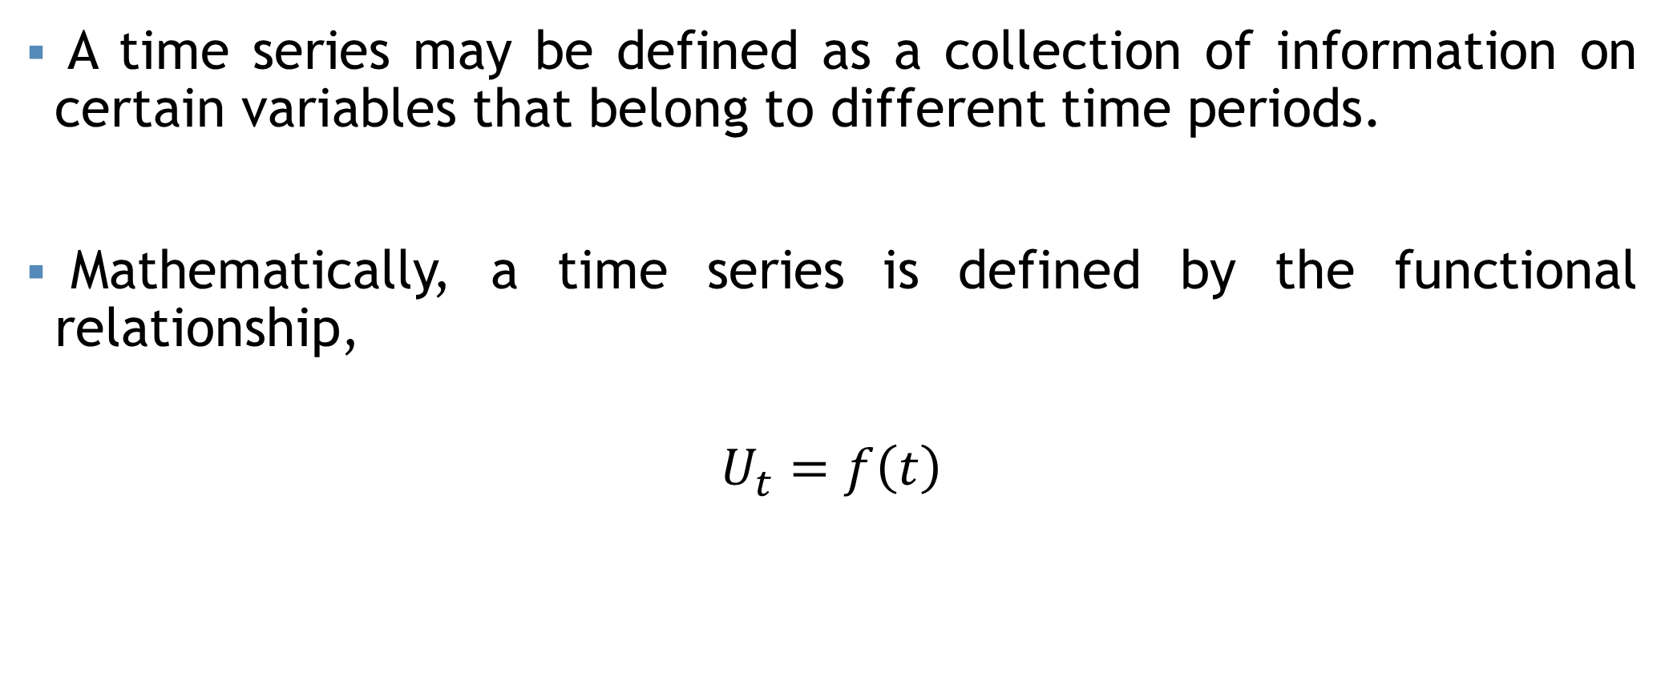



Time Series
A time series may be defined as a collection of information on certain variables that belong to different time periods.
Mathematically, a time series is defined by the functional relationship,
$$U_{t}=f\left(t\right)$$
$$t=t_{1},t_{2},…,t_{n}$$
$$U_{t}=U_{1},U_{2},…,U_{n}$$
For example, the population $\left(U_{t}\right)$ of a country in different years $\left(t\right)$
For example, the sales $\left(U_{t}\right)$ of a store in different months $\left(t\right)$

Slide 3
Why Time Series Analysis?
Studying time series helps us identify patterns and trends in data over time.
Forecast future values of variables, aiding in planning and decision-making in various domains such as finance, economics, and weather prediction.
Time series data provides insights into the effectiveness of policies and interventions over time.

Slide 4
Components
Change of data with change of time depends on a number of causes.
These causes are known as the “Components of time series”
The components of time series are:
Trend or Secular trend
Seasonal variation
Cyclical variation
Irregular variation

Slide 5
Trend/Secular Trend
Long term upward or downward tendency of a variable is knowing trend/Secular trend/Long term movement.
The aims of measurement of trend are:
To study the past behavior of the variable under consideration.
To predict or forecast the future behavior of the variable.

Slide 6
Measurement of trend
The following methods are used in measuring trend:
Graphical methods
Semi-average method
Method of moving average
Method of least square

Slide 7
Moving average
The data on the rice production during 1980-90 in a certain region are given bellow:
Year | Production
1980 | 280
1981 | 300
1982 | 325
1983 | 420
1984 | 315
1985 | 360
1986 | 400
1987 | 450
1988 | 350
1989 | 420
1990 | 460
Determine the trend using 4-year cycle period.

Slide 8
Moving average
Year | Production
1980 | 280
1981 | 300
1982 | 325
1983 | 420
1984 | 315
1985 | 360
1986 | 400
1987 | 450
1988 | 350
1989 | 420
1990 | 460
4 year moving total
4 year moving avg.
Centralized
1325
331.25
335.63
1360
340.00
347.50
1420
355.00
364.38
1495
373.75
377.50
1525
381.25
385.63
1560
390.00
397.50
1620
405.00
420.00
412.50
1680

Slide 9
Moving average

Slide 10
Moving average
The data on the rice production during 1980-09 in a certain region are given bellow:
Year | Production
1998 | 5
1999 | 6
2000 | 8
2001 | 10
2002 | 5
2003 | 3
2004 | 7
2005 | 10
2006 | 12
2007 | 11
2008 | 9
2009 | 13
Determine the trend using 3-year cycle period.
Determine the trend using 5-year cycle period.

Slide 11
Seasonal variations
Seasonal variation means short term variation.
Time series data exhibits some changes which may be weekly, monthly, quarterly or half yearly.
This type of change may occur once or more than once within one year period.

Slide 12
Causes of Seasonal variations
There are two reasons behind the occurrence of weekly, monthly, quarterly or half yearly change within the same year:
Influence of natural forces.
Change of taste or habit.
For example, demand increases for worm cloth in the winter, air condition in the summer, umbrella in the rainy season.
For example, demand of new clothes increases at the time of religious festivals.

Slide 13
Cyclical variations
Cyclical variations are recurrent upward or downward movements in a time series but the period of cycle is greater than a year.
Once complete period is
called a “Cycle”.

Slide 14
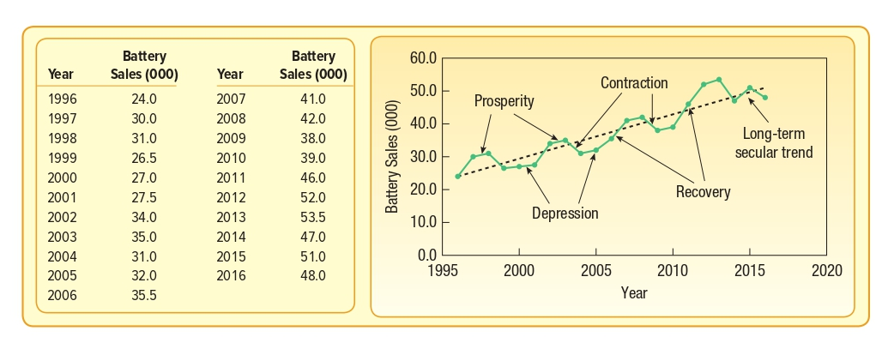

Slide 15
Irregular movement
Besides trend, seasonal variation and cyclical fluctuations, there are other factors which cause variations in time series.
For example, flood, draught, earthquake, war and so on.
These variations are known as “Irregular movement”.
These factors are beyond control, unexpected and unusual.

Slide 16
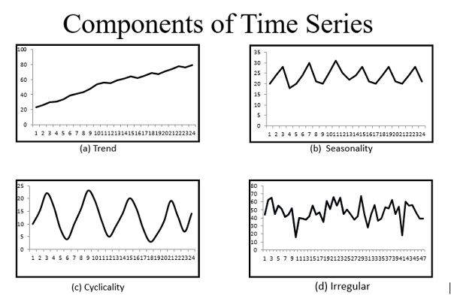

Slide 17
Thank You

